Slide 1
Components of visual interfaces
Graphical Elements: Include icons, buttons, menus, images, and charts that convey information and enable interaction. For example, a trash can icon for deleting an item.
Layout: Involves structuring elements in a visually appealing and intuitive way to guide user navigation, like using grid layouts or navigation bars.
Colour and Typography: Use of colour schemes and font choices to enhance readability, create visual hierarchy, and convey meaning (e.g., red for errors, green for success).
Animation: Visual responses, such as button animations or loading spinners, confirm actions and enhance the interface's responsiveness.
Responsive Design: Ensures interfaces adapt to various screen sizes and devices, maintaining usability across platforms.
User Interaction: Enables actions like clicking, tapping, or swiping, with visual cues guiding these interactions (e.g., touch-friendly elements on mobile apps).

Slide 2
Emotion in HCI
Emotional Design: Focuses on creating interfaces that evoke positive emotions and user delight, like playful animations in educational apps.
Emotion Recognition: Detects user emotions through facial expressions or voice to adapt the interface, such as mood-tracking apps that suggest relaxation exercises. Systems that understand and respond to emotions, like chatbots that detect frustration and offer human assistance.
Emotionally Engaging Interfaces: Designed to emotionally captivate users, such as video games with compelling stories that evoke empathy.
Empathy and User-Centered Design: Prioritizes users' emotional needs by understanding their feelings, like calming visuals in mental health apps.
Empathize methods: photo/video based observations, conduct interviews with empathy, engage with extreme users, bodystorm, journey mapping

Slide 3
Multi User Interaction
Systems that facilitate collaboration and simultaneous interactions between multiple users and a system.
Some examples of multi-user interfaces:
Virtual Reality (VR) and Augmented Reality (AR)
Multi-touch Tablets
Collaborative Gaming Platforms
Online Learning Platforms
Virtual Meeting Spaces
Collaborative Design Tools

Slide 4
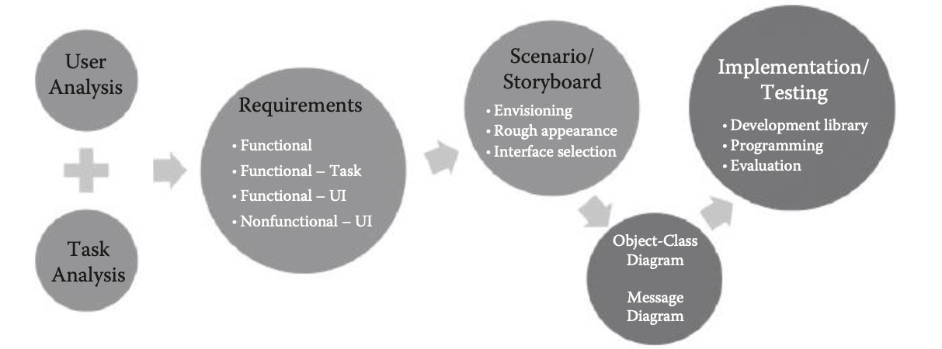
Interface Selection Options
Each sub-task
Software Component
Hardware Component
Desktop
Smartphones
Tablet
TV
Kiosks
Virtual reality
Icons
Menus
GUI component
Text box
Toolbar
Forms
Dialog boxes

Slide 5
Wire-Framing
Skeletal framework of a website or interface depicting the page layout, arrangement of the UI objects and how they respond to each other
Connect the site’s information architecture to its visual design by showing paths between pages
Determine intended functionality in the interface
Prioritize content through the determination of how much space to allocate to a given item
Types of wireframes:
Low-fidelity wireframes : quick to develop. They tend to be more abstract because they often use simple images to block off space and implement mock content as filler for content and labels.
High-fidelity wireframes : Better for documentation because of their increased level of detail. Include information about each particular item on the page, including dimensions, behaviour/actions related to any interactive element.

Slide 6
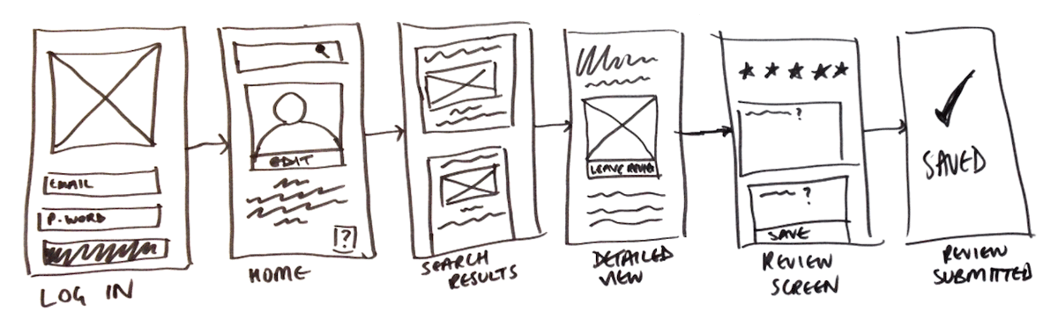
Steps for Wire-framing
Focus on functionality, accessibility, layout and navigation to make a design easier to use, produce and sell
Structure a hierarchy with a list of prioritized elements for each page
Divide the screen into large blocks for content. Maintain a clean grid-oriented view.
Use annotations (links, placeholders for images, headers, footers, logos) to help others understand your wireframes faster.
With higher-fidelity wireframing, be more specific – Although you shouldn’t overdo content, still show what needs to appear and accurate sizes of fonts, icons, links, etc
Do not use colors. Instead rely on various gray tones to communicate the differences.
Do not use images. To indicate where you intend to place an image and its size, you can instead use a rectangular box sized to dimension with an “x” through it.
Use only one generic font. Typography should not be a part of the wireframing discussion.

Slide 7
Design process in HCI
Analyzing Users and Determining Needs
Creating a Design
Testing the Initial Design
Developing a Prototype System
Refining Specific Interfaces
Iterative Design Process
Implementing the Interface

Slide 8
User focus in HCI
It involves understanding users' needs, preferences, abilities, and limitations to create interfaces and systems that are intuitive, efficient, and satisfying to use.
User-Centered Design: Involves users throughout the design process to ensure products meet their needs using methods like research and usability testing.
User Research: Gathers insights into users' behaviors, goals, and preferences through methods like interviews, surveys, and usability studies.
Usability Testing: Observes users interacting with a system to identify usability issues and improve the experience.
Accessibility: Ensures technology is usable by individuals with disabilities, providing features like screen reader support and alternative navigation methods.
User Interface (UI) Design: Focuses on creating visually appealing and intuitive interfaces using principles like consistency and feedback.
User Experience (UX) Design: Encompasses the overall interaction experience, considering ease of use, efficiency, and emotional impact.

Slide 9
Scenarios
A good user scenario is a detailed description of your user within a specific context in relation to your solution
Context: Describe the situation and steps your user takes to arrive at your product/service
Goals: What do they want to achieve?
Problems: What are they trying to solve and what obstacles do they encounter?
Motivations: Why do they need or want your offering?
Relevant habits: Actions and emotions that occur in relation to your product/service add a layer of context
Demographics: Relevant info about location, income, occupation, marital status, etc.
User scenarios vs. user stories vs. storyboard
User stories focus on the user's perspective and highlight general character traits related to the product.
User scenarios provide more detailed information about a user's persona, how they interact with the product, and the reasons behind their actions. They offer a deeper understanding of the user's journey, including the steps they take to achieve their goals.
After developing a user scenario, a storyboard visually represents how the user interacts with the product. Illustrations, sketches, screenshots, slideshows, and animated demos are different storyboard types.

Slide 10
Example 1
Sheryl is a Marketing Manager in Las Vegas, and she has a business trip coming up in Northern California. The trip is half pleasure, half work, and she wants to do some hiking in the mountain trails. She knows the roads can be pretty bumpy, so she wants to rent a car that is suitable for off-road driving. Sheryl discovers a car website to find the perfect car. She is unfamiliar with these types of vehicles, so she compares some models and reads the reviews to get a better idea of her best option. When she finds one she likes in the budget allotted by her company, she books it.
Context: Renting a car for a business trip
Goals: Sheryl wants a car that is reliable for off-road driving and within her company’s budget
Problems: She’s unfamiliar with these types of vehicles
Motivations: Hiking in the mountains while on her business trip, and arriving at the trails safely
Personal traits: Adventurous, outdoorsy, safety-minded
Relevant habits: Hiking
Demographics: Female, Marketing Manager in Las Vegas

Slide 11
Example 2
Jeremy, a senior manager for a medical supplies company, begins his day by commuting between work and hospital sites. During his commute, he struggles to stay updated on purchasing-related issues and industry news due to his busy schedule and the recent layoffs in his company.
He feels overwhelmed managing tasks previously handled by his assistant, including staying current with industry news, investigating supply-chain problems, and finding cost-effective alternatives. This leaves him drained and unable to enjoy his career.
Jeremy wants a convenient solution to access only the most relevant updates and industry news while on the go. He desires an app that provides real-time information feeds on share prices, tariffs on foreign suppliers, budget decisions in local hospitals, and innovations in the medical devices he handles.
Instead of spending an hour generating end-of-day reports through the company intranet and liaising with three other managers, Jeremy wishes to have all necessary information securely accessible on his smartphone. He envisions easily sending real-time screenshots for junior staff to action and file, while also allowing corporate heads to examine and advise him about.
User Persona:
Name: Jeremy
Age: 52
Occupation: Senior Manager at a medical supplies company
Skills: Highly skilled, organized, diligent
Current State: Struggling to manage workload due to recent layoffs, feels drained and unable to enjoy career
Interests: Staying updated on purchasing-related issues, optimizing resource allocation, investigating supply-chain problems, finding economical alternatives
Products/Services Used: Company intranet for generating reports, liaising with other managers

Slide 12
Goals:
Access relevant updates and industry news conveniently while traveling between work and hospital sites.
Optimize resource allocation and make informed decisions about purchasing-related issues.
Reduce time spent generating reports and liaising with other managers by streamlining information access and communication processes.
Problems:
Struggles to manage workload and stay updated on industry news due to recent layoffs and increased responsibilities.
Feels drained and unable to enjoy career due to overwhelming workload and lack of efficient tools.
Wastes time generating reports and liaising with other managers through traditional methods, hindering productivity.
Motivations:
Need for convenience and efficiency in accessing relevant information while on the go.
Desire to optimize resource allocation and make informed decisions to navigate the current financial climate successfully.
Aspiration to streamline communication processes and reduce time spent on administrative tasks to focus on core responsibilities.
Demographics:
Age: 52
Occupation: Senior Manager
Income: Likely high income given senior managerial position
Location: Possibly urban area with access to hospitals and corporate headquarters
Marital Status: Not specified, but likely in a committed relationship or married given his senior position and age.

Slide 13
Example
User story from Sam: “I want to invite my students to teach them on this platform.”
User scenario:
Sam has just logged into his teacher portal after waiting in morning traffic for 40 minutes. His coffee is getting cold, and he just wants his teaching platform set up before the school day starts.
As he takes his first sip of coffee, he realizes he still needs to invite the students. He rushes to figure out the system, texting his fellow teacher down the hall to see if they know how it works.
Before they can reply, Sam sees the “invite your students” call-to-action button and presses it. He sees a clear list of his students, the ability to “select all,” and the “invite” option, which he clicks.
Sam finishes sipping his coffee as he watches his students arrive in his virtual teacher portal.

Slide 14
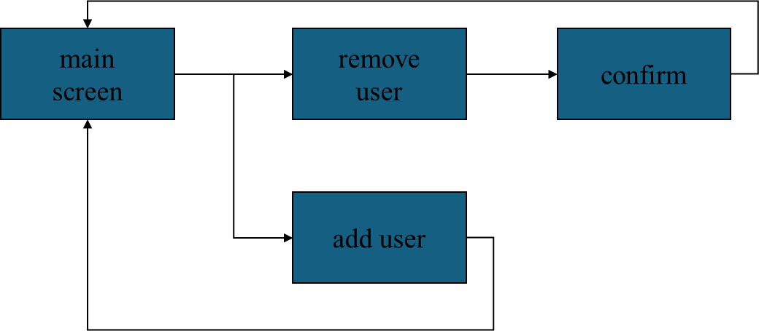
hierarchical diagrams
network diagrams
the system
info and help
management
messages
add user
remove user
Four golden rules
knowing where you are
knowing what you can do
knowing where you are going or what will happen
knowing where you’ve been or what you’ve done

Slide 15
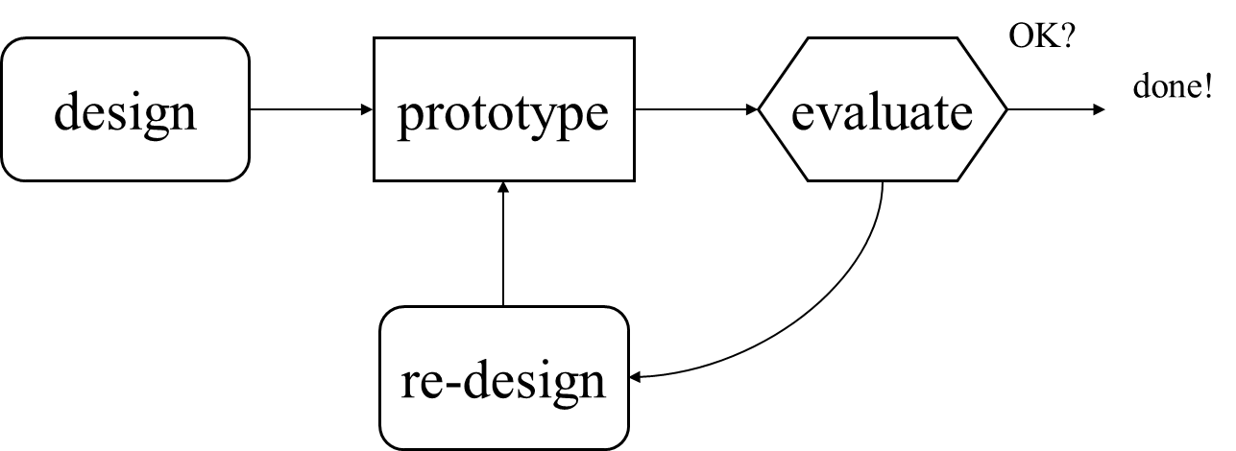
Prototyping
Types of prototypes:
Low-fidelity prototypes - explore and generate different concepts quickly and cheaply. Eg- sketches, wireframes, paper models
High-fidelity prototypes - to demonstrate and validate specific features and functionalities in a realistic context. Eg- mockups, simulations, working versions
Benefits:
User Feedback
Iterative Design
Risk Reduction
Visualization
Stakeholder Engagement

Slide 16
Storyboards
Series of sketches showing how a user might interact with the technology or progress through a task
Pros:
Simple to design by yourself
Makes you think through the process of how something will be used and identify needed features
Useful for communicating ideas
Getting feedback from users early in the process. Iterative approach
Stories capture attention. Curiosity and empathy for characters draws us in and we engage more.
Cons
Rough sketches, not everything can go in
Limited in scope, impractical to use on a whole project

Slide 17
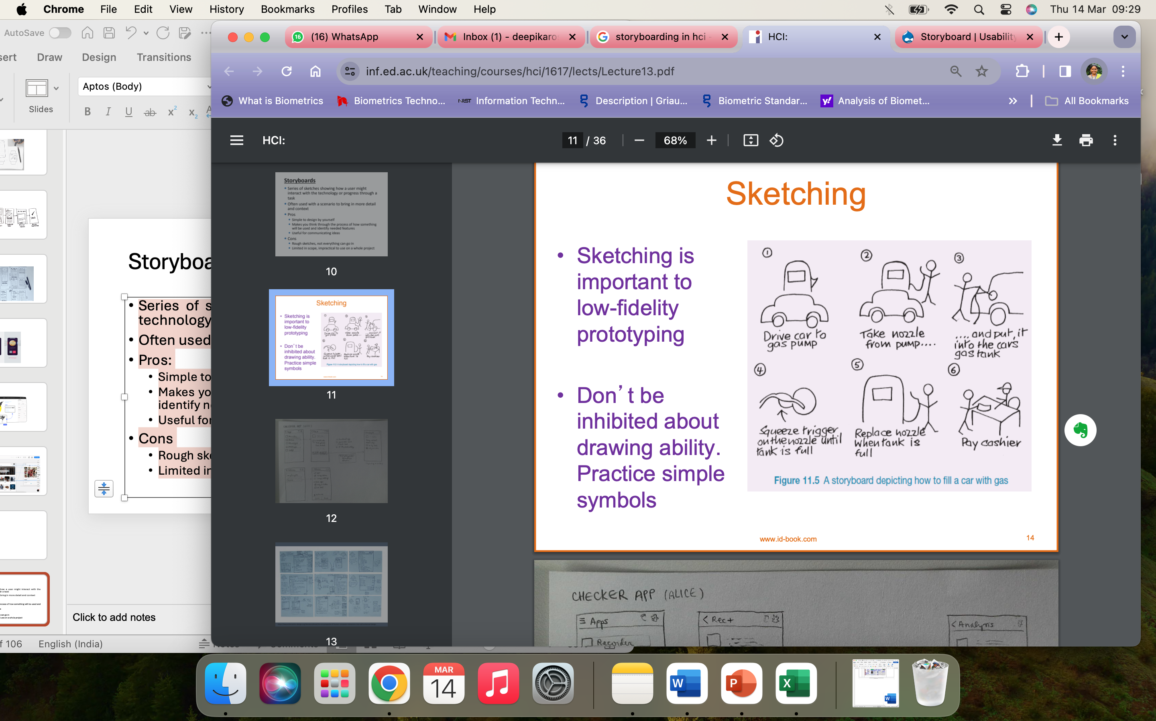
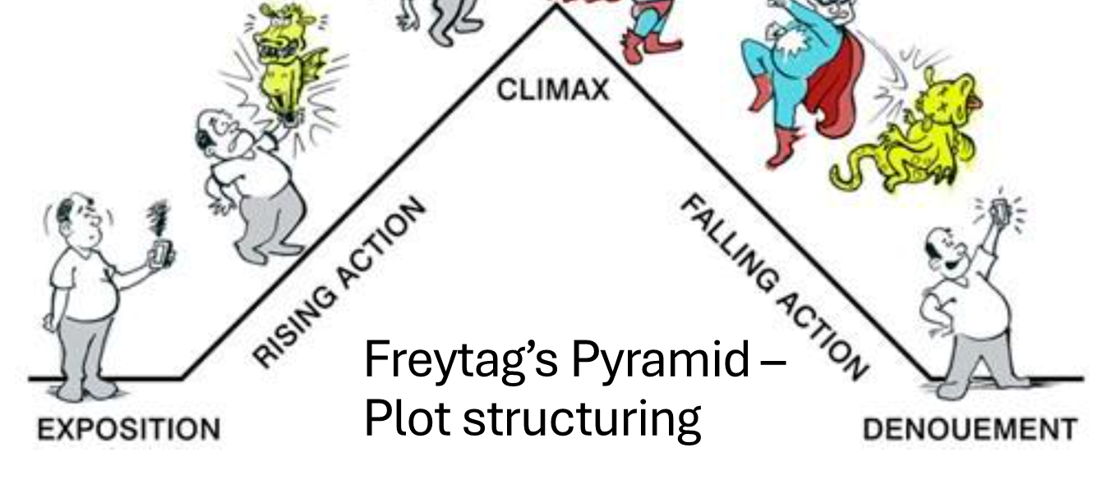
Storyboarding Scenario: Ordering Coffee Through a Mobile App
Scene 1:
Frame 1: A person is waking up in the morning, looking tired.
Frame 2: The person picks up their smartphone from the bedside table.
Frame 3: Close-up of the smartphone screen showing a coffee cup icon.
Scene 2:
Frame 4: The person taps on the coffee cup icon.
Frame 5: A menu of different coffee options appears on the screen.
Frame 6: The person selects a latte and adds it to the cart.
Scene 3:
Frame 7: The person proceeds to checkout.
Frame 8: Payment options are displayed on the screen.
Frame 9: The person selects a payment method and confirms the order.
Scene 4:
Frame 10: A confirmation message pops up on the screen.
Frame 11: The person smiles and gets out of bed.
Frame 12: The person is now at a cafe, picking up their freshly brewed latte.

